Slide 1
1. Open IC measure software to capture the images
- Device drop down menu and select the name of the camera
- HRD should be unenabled to prevent artifact images
- Enabled index starting at 1
- Click Save to Capture (to capture a sequence images) x 25 images per 1 drilling increment.
2. UGS Universal G-code Sender
- Conect button to conect the software to the controller board
- To run the code, need following steps: Soft Reset --> Unlock --> Send
- Check the position of the drilling
note: g28 z0 x0 ; home device to absolute position
g1 x-75.2 z-81.5 f500 ;; move to predetermined drilling position, allow for clearance for z axis EDIT THIS LINE ACCORDING TO YOUR MEASUREMENT.
(81.5 = touching height position - 2;)

Slide 2
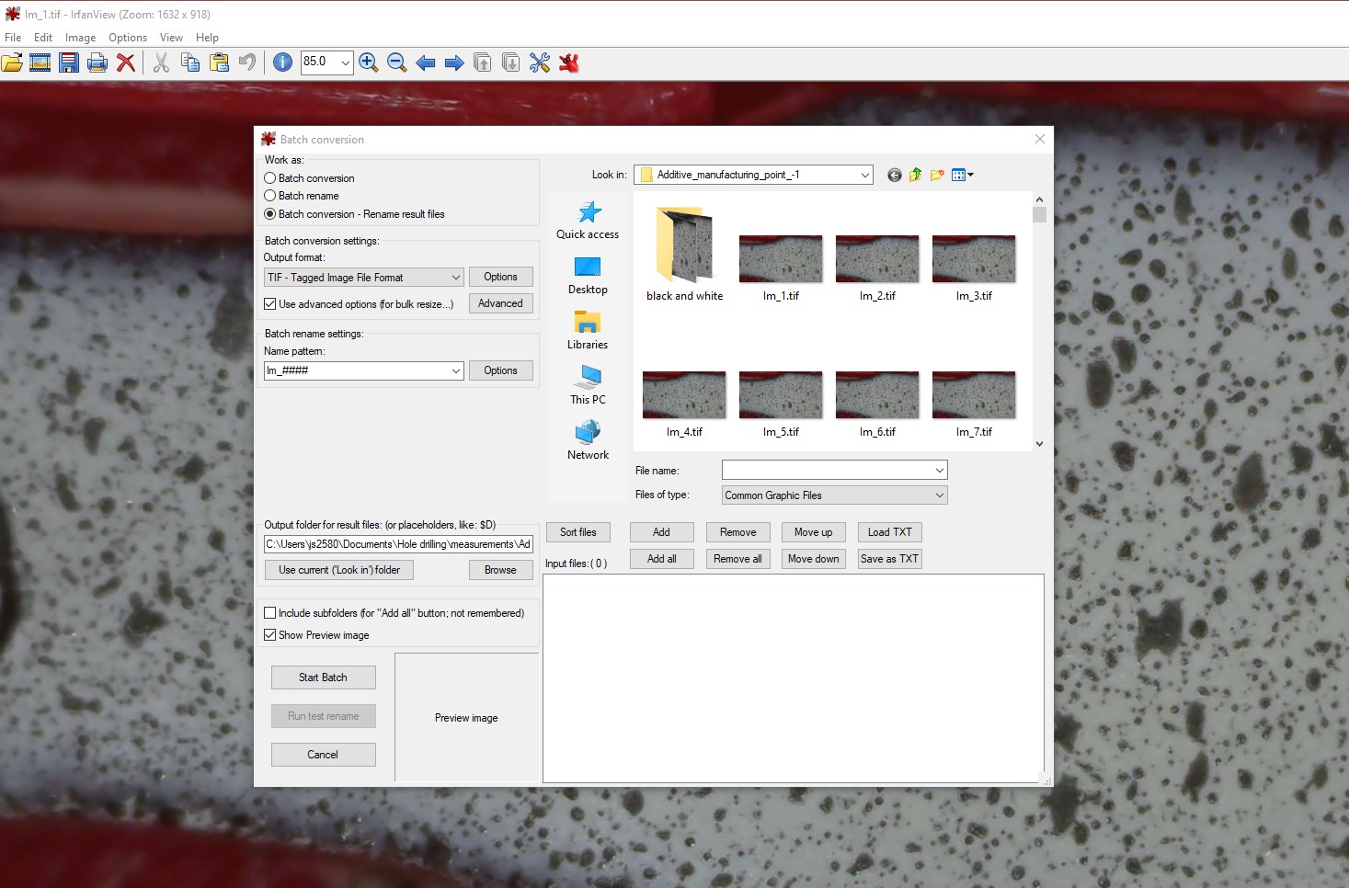
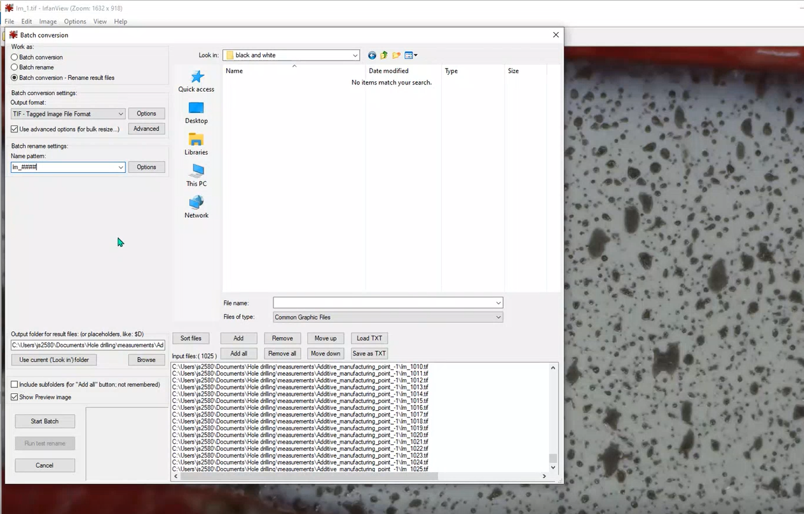
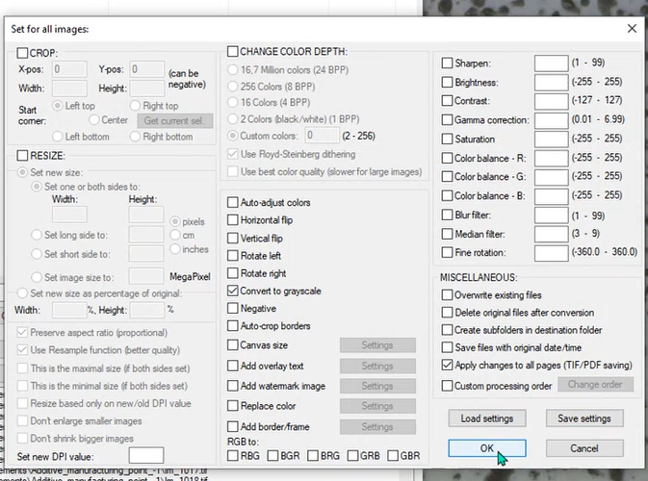
Pre-processing DIC: converting B&W images
IrfanView 64
1. Open image file from the processing directory
Alternative method can be done in imageJ
2. Select File→ Batch conversation/Rename
3. Add all images that need to be processed
* Make sure the images are in the right order
4. Set options as shown
5. Start Batch

Slide 3
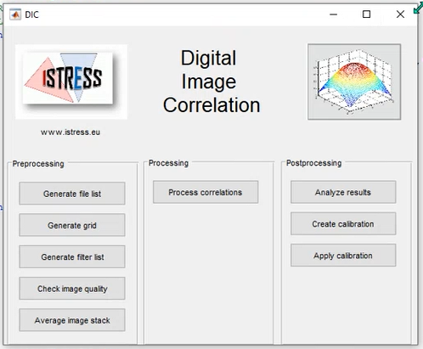
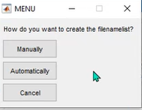
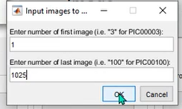
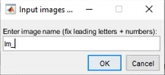
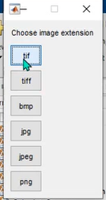
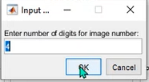
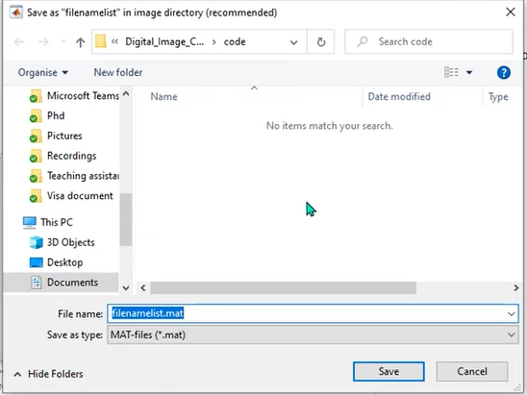
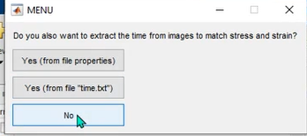
Pre-processing DIC: Apply average image value
iStress DIC
6. Download Istress matlab code from https://uk.mathworks.com/matlabcentral/fileexchange/50994-digital-image-correlation-and-tracking
7. Copy B&W images from the previous steps into the Istress directory
8. Open DIC.m
9. Following the steps in the Pre-processing block → Generate file list
10. Average image stacks

Slide 4
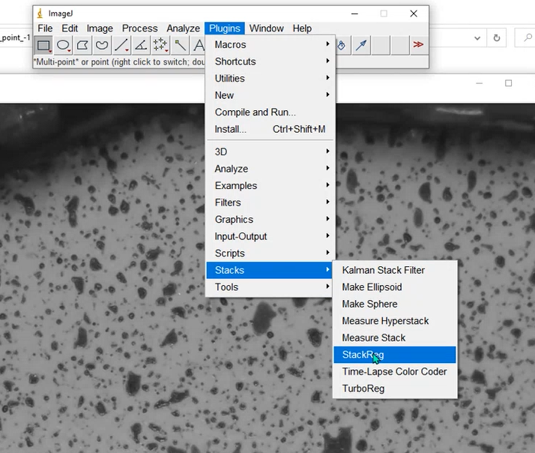
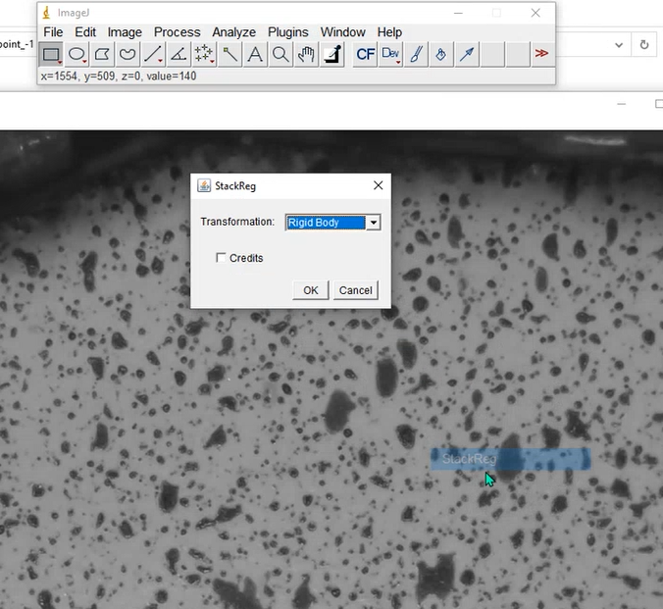
Pre-processing DIC: Apply rigid body
ImageJ
11. Download StackReg + TurboReg http://bigwww.epfl.ch/thevenaz/stackreg/
12. Import the sequence of the average images to form a stack image
13. StackReg → Rigid body
14. Save as the Rigid images and change name with Irfanview if necessary

Slide 5
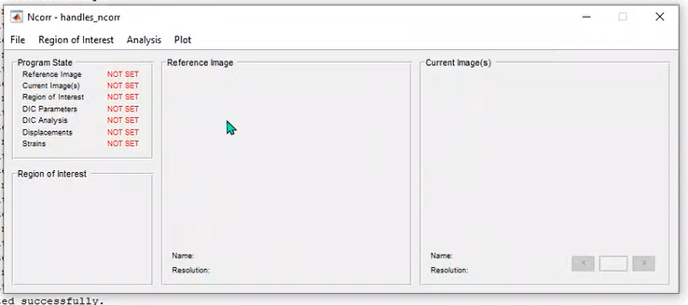
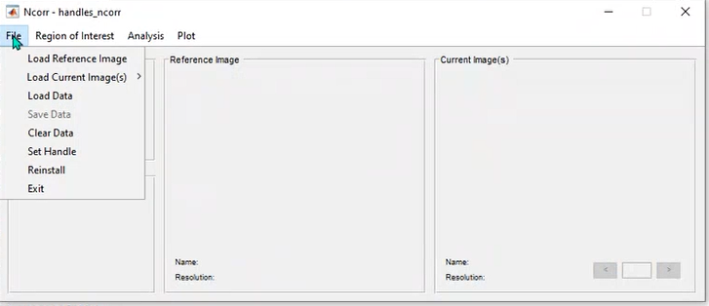
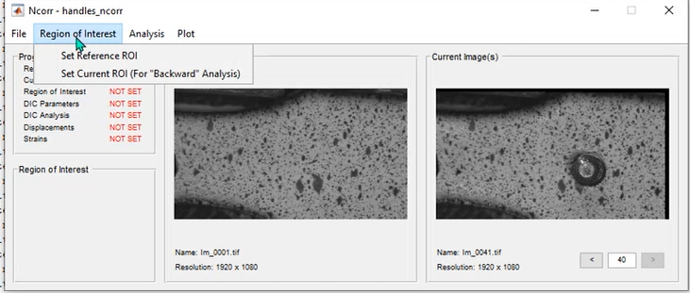
Processing DIC: Ncorr
Download Ncorr: http://www.ncorr.com/index.php/downloads
Download Ncorr post: http://mech.fsv.cvut.cz/~nezerka/DIC/index.htm
Put Ncorr post inside Ncoor directory
At Ncorr master directory Right Click → Add path
Type handles_ncorr = ncorr to run the software
Set up the CPU core
Follow in figures
First image
All the rest images; Load all memory

Slide 6
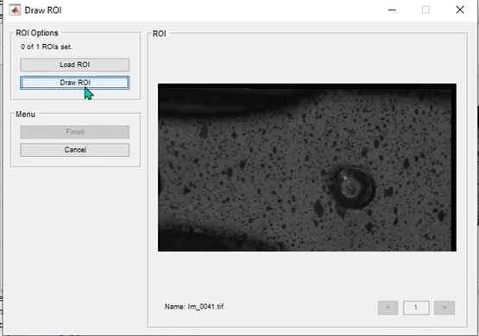
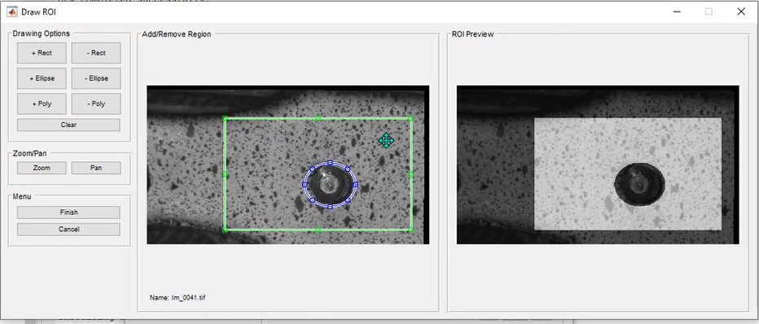
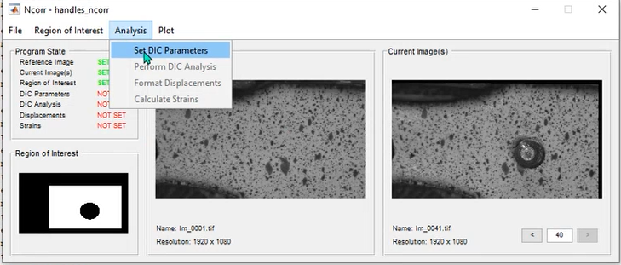
Processing DIC: Ncorr
Include Rectangle area
Exclude Elipse area

Slide 7
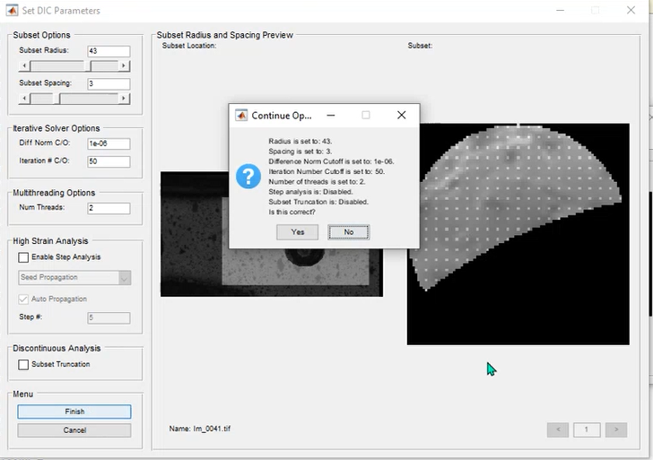
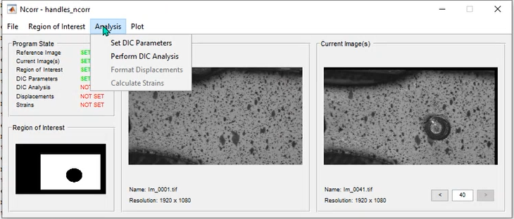
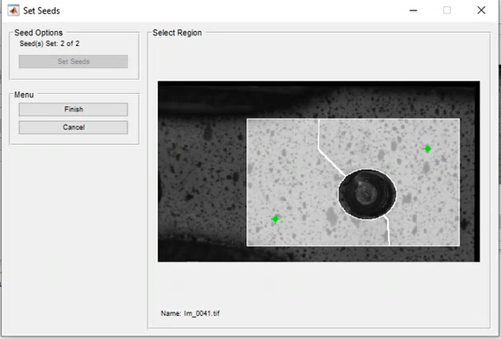
Processing DIC: Ncorr
22. Use the default value or change the subset radius or subset spacing, if necessary but it will increase computational cost
23. Click set seeds to locate the seeds points: Try to make the areas to be symmetric as much as possible, see literature for more details
24. Click finish after satisfy with the points

Slide 8
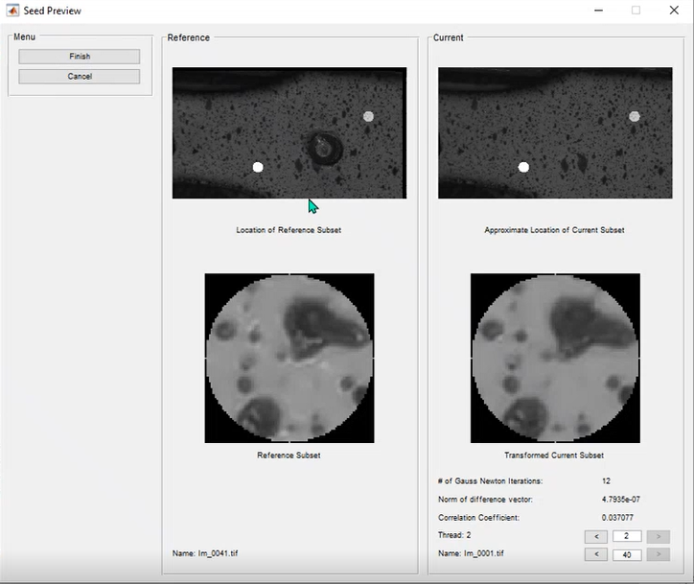
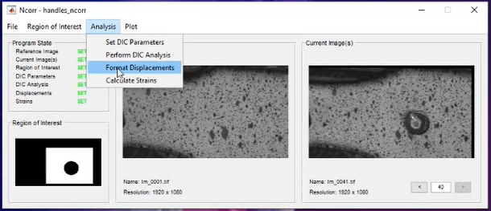
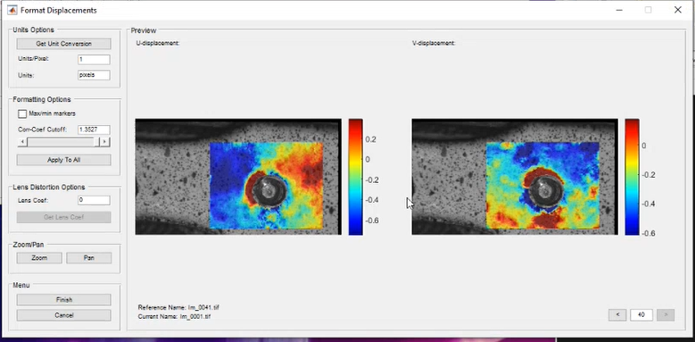
Processing DIC: Ncorr
25. Compare the reference image with the current image to see the movement of the speckles point
26. Make sure the Correlation coefficient is low
Post-processing: Ncorr

Slide 9
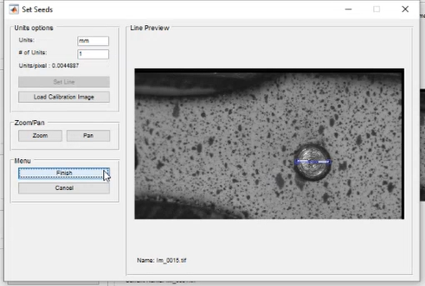
Post-processing: Ncorr
29. Set the unit and # of Units (size of the hole is 1mm in this case)
28. Draw a line across the hole
27. Load reference image to measure the size of the hole

Slide 10
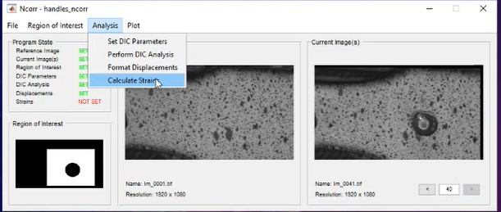
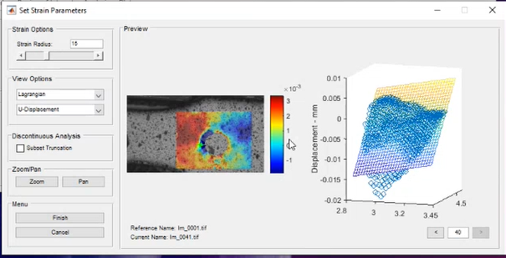
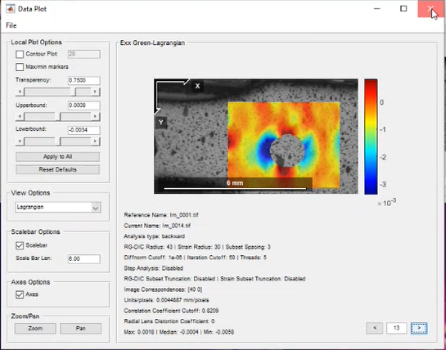
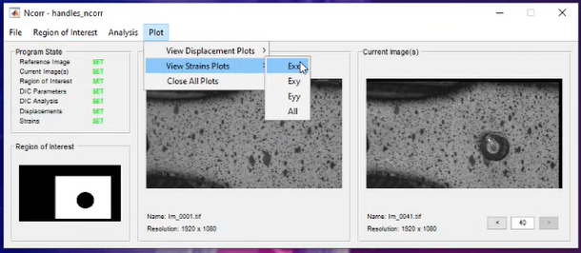
Post-processing: Ncorr
30. Change Strain radius, if necessary, to smooth the results
Fit data
Individual track points

Slide 11
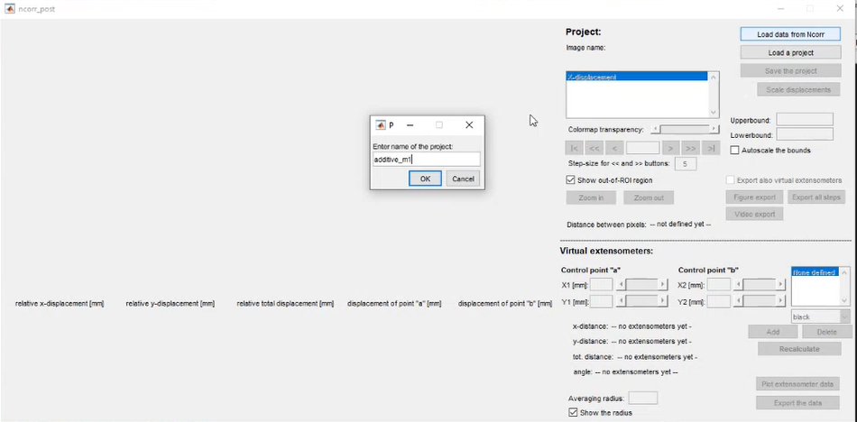
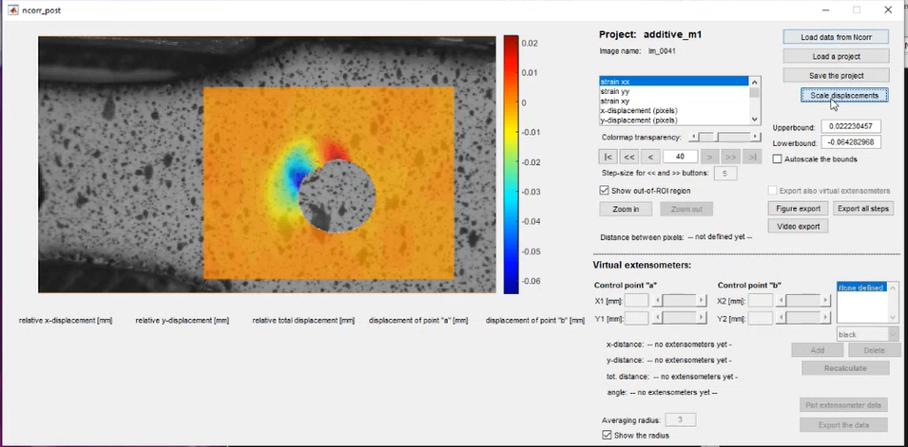
Post-processing: Ncorr post
32. Load image (make sure path has been added properly)
31. Run ncorr_post.m
33. Enter project name
34. Set scale again

Slide 12
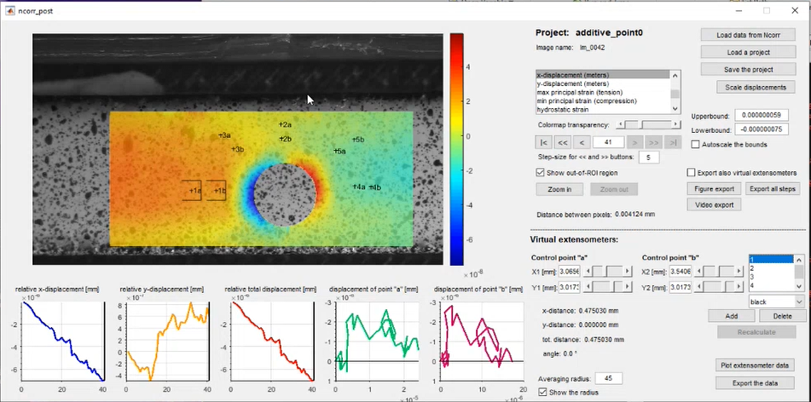
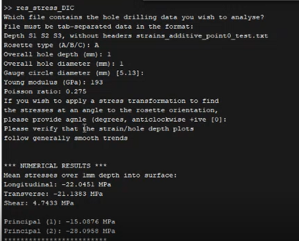
Post-processing: Ncorr post
35. Add extensometers
36. Export the xx,yy,xy data and convert them into text-delimited format
37. Download res_stress_DIC.m to convert strain into stress but it can only can handle upto 1mm depth
38. Type the following properties
Calibration factor
File name

Slide 13
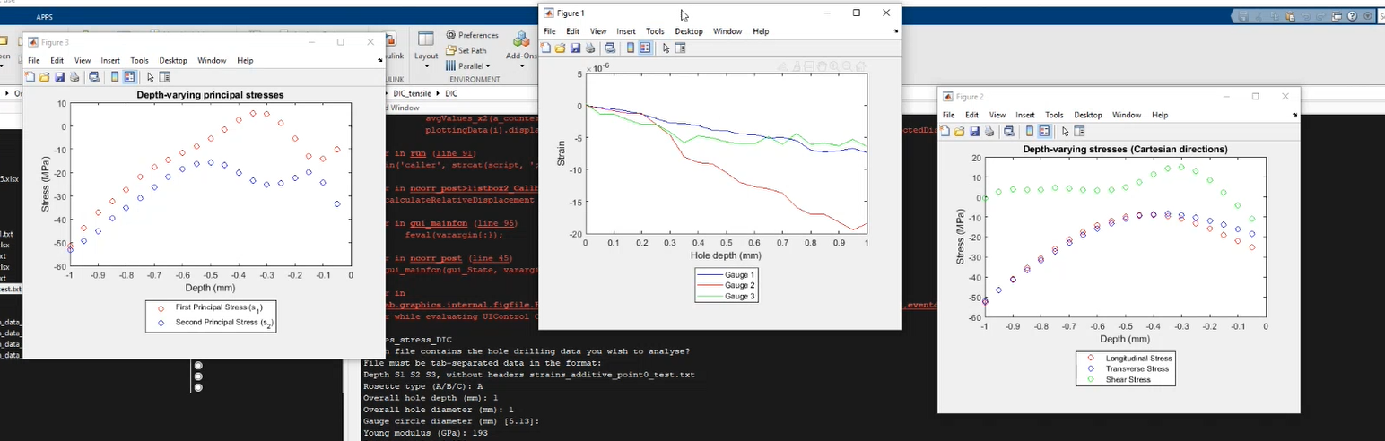
Post-processing: res_stress_DIC.m
39. Results

